Slide 1

Faculty of Science Department of Computing and Information Systems (COIS)
COIS 2830
Multimedia and Design
Danny Papagiannis
Andy Reid
Thomas Hughes

Slide 2
First, Talk Lab/Photoshop Stuff
A: Lab 2 is too long, but as long as you’ve got some of it done you’re ready to go.

Slide 3
Functionality And UX

Slide 4
Functionality
(Probably too broadly) we can break down software functionality into 3 areas:
Presenting information
Getting information
System level operations

Slide 5
Other Examples of Functional Requirements
Business Rules
Transaction corrections, adjustments and cancellations
Administrative functions
Authentication
Authorization levels
Audit Tracking
External Interfaces
Certification Requirements
Reporting Requirements
Historical Data
Legal or Regulatory Requirements
You don’t need to remember these (this is more COIS 3030H and 2240H)
https://reqtest.com/requirements-blog/functional-vs-non-functional-requirements/
Notes:
https://reqtest.com/requirements-blog/functional-vs-non-functional-requirements/

Slide 6
What Do We Mean?
You build a product that accomplishes some functional thing
That usually means presenting or gathering information based on some requirements. e.g.
Only show certain information to administrators
Show news articles to users sorted by date
Allow users to search for data based on keywords (the user needs to input keywords)
System level might be something like “Move data more than X old to an archive”

Slide 7
Systems Can be Complicated
The New York Times website basically just displays text, images and video for users. Which is what your pages on Loki do.
But the NYT archives go back to 1851.
Statscan can provide you data…. Which looks like a giant mass of unreadable data.

Slide 8
Product Design
At a high level, when you design a product you list the key functional requirements
E.g. What are the key functional requirements of a toaster?
(Could also consider parking meter, or a garbage can or remote control)

Slide 9
Key Functional Requirements of your Website
The Website for us needs to display your assignments
That means links to each assignment, a way to access the files
On the back end of that means you need a way to access the site.
We’re using a standard protocol (sftp), with common software to let you do that, but it could have been a custom tool instead.

Slide 10
Front End vs Back End
Front end work is largely the stuff people see – user interfaces basically
On the web this is HTML, CSS and Javascript (we’ll do more on HTML and CSS either in lecture 3 or 4, and then later in the course).
Back end is the server side of things – when you enter data into a form where does it go? You can also generate pages on the backend that appear on the front (that’s webapps)

Slide 11
The Design of Everyday Things
Keyword from the book: Affordances
Affordances are what a product can do.
In product design it’s basically all possible interactions between the users and the product. (For complex products you may never explicitly list all of these thing because they become more and more ridiculous)

Slide 12
Deciding on Affordances
A designer needs to decide what features should be available
To go with that is understanding who is using your system and what they want to accomplish with your system
To callback to lecture 1: MS word affords you a lot of drawing tools… that the vast majority of users are unaware of and don’t want

Slide 13
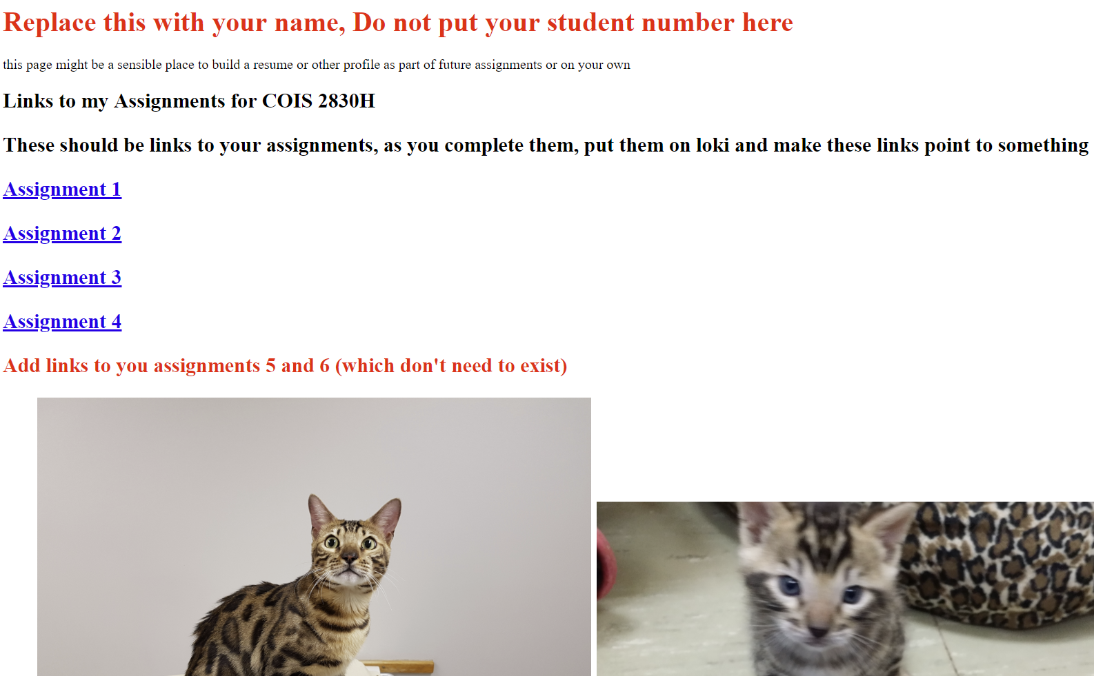
The Connection With UX
If you look at the website from lab 1:
It meets many functional requirements. But it looks like crap.

Slide 14
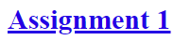
A Simple Problem
We have these links to assignments e.g.
Hopefully it’s obvious what is supposed to do
The reason we’re doing it this way is that in previous years students made their own.
Assignment1.html assignment1.html Assignment 1.html assignment 1.html 2830A1.html etc. are in fact not the same name
A lot of TA time was spent trying to find out what students named their assignments to find them.

Slide 15
Discoverability
That basic issue, what to name a file, is a problem in a core concept called Discoverability
A product is useless if people can’t find it, or can’t figure out how to use it
There are some specific things with the technical side of discovery (e.g. keyword databases), that aren’t hugely relevant to us. But the broader concept is what we’re going to look at

Slide 16
Discoverability, People Vs Computers
Around lectures 8 and 9 we’ll talk about how it’s different to design for people versus bots
That’s sort of a functional thing too. When you ‘search’ the web really a bot is trying to find things relevant to your search terms
So that’s a computer trying to find and categorise data for you

Slide 17
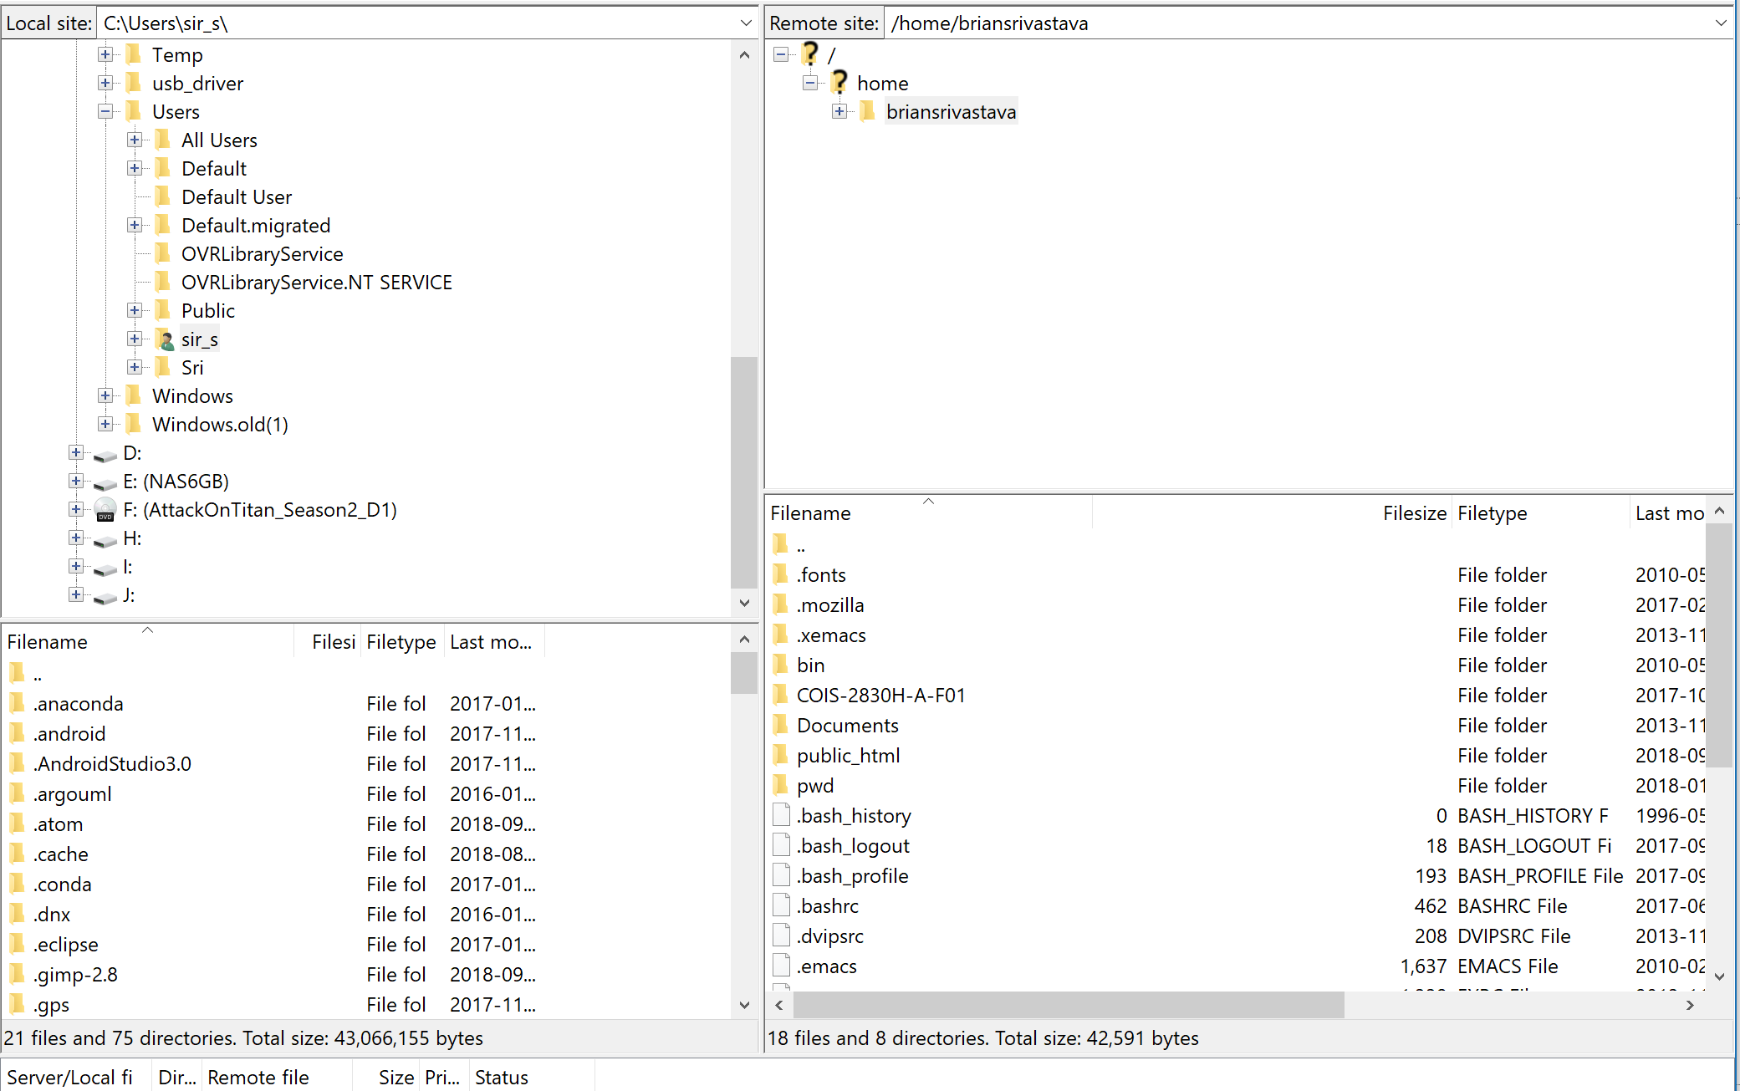
Discoverability example (Filezilla – Loki)
Notes:
There’s a lot of discussion here

Slide 18
Important factors
The left side is the file system on your computer. Lots of people had trouble even finding where the files ended up on their own computer
(Even worse was the students on lab computers)
You can’t really use any of these tools if you have no idea what the information it is showing you means

Slide 19
File Systems
We sort of talked about this week 1. Windows having grown up more directly tied to hardware used to be conceptually easier to understand, in the 1990’s you’d have a c:\downloads for example. C is a physical drive. Downloads is a directory (folder) that has your downloads. Simple, maps to hardware. If your C drive dies, you lost your downloads.
Linux and Mac having come out of Unix systems were built around user accounts on mainframes. They deliberately hide things and have more opaque file systems that work better on network environments.

Slide 20
Good/Bad
The problem of course is that Windows needed user accounts.
And in a network environment you can have a situation where you have
C:\users\username\downloads
AND H:\username\downloads
(or desktop or whatever) and good luck figuring out which one is the default for anything, because not everything will use the same default.

Slide 21
Libraries
Microsoft had the idea of Libraries
A library is a glorified collection of links to several directories
Not every piece of software (including Filezilla and WinSCP) can access or understand libraries
Libraries can’t be easily replicated

Slide 22
User Experience (UX)
This course is only a gentle introduction to the concept of user experience, it falls broadly into that discipline
User experience is not what can the product do (or how does it to it), rather, it’s what can a user do with the product, and did they enjoy it

Slide 23
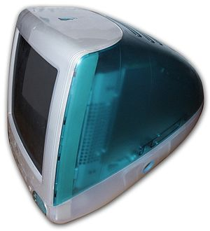
Apple The Off and On Kings of UX
In the late 1990’s every computer was beige, white or black
Then came the imac g3
Which came in colours! (It was, this weird running joke that you’d spent $5K on a computer but you couldn’t get it in whatever colour you wanted).
This was basically how Jobs returned to Apple after they fired him
Notes:
https://en.wikipedia.org/wiki/IMac_G3

Slide 24
Elegant (expensive) simplicity
There are lots of things wrong with elegant simplicity. The G3 supported USB, which was good, but more or less did away with all previous port types, as well at the 3.5 inch floppy
That drove up costs for anyone who had old peripherals that worked, they needed new ones
Same with software on a 3.5 inch drive
Backwards compatibility is a difficult, expensive problem to solve (and net week we’ll talk security which makes it even worse)

Slide 25
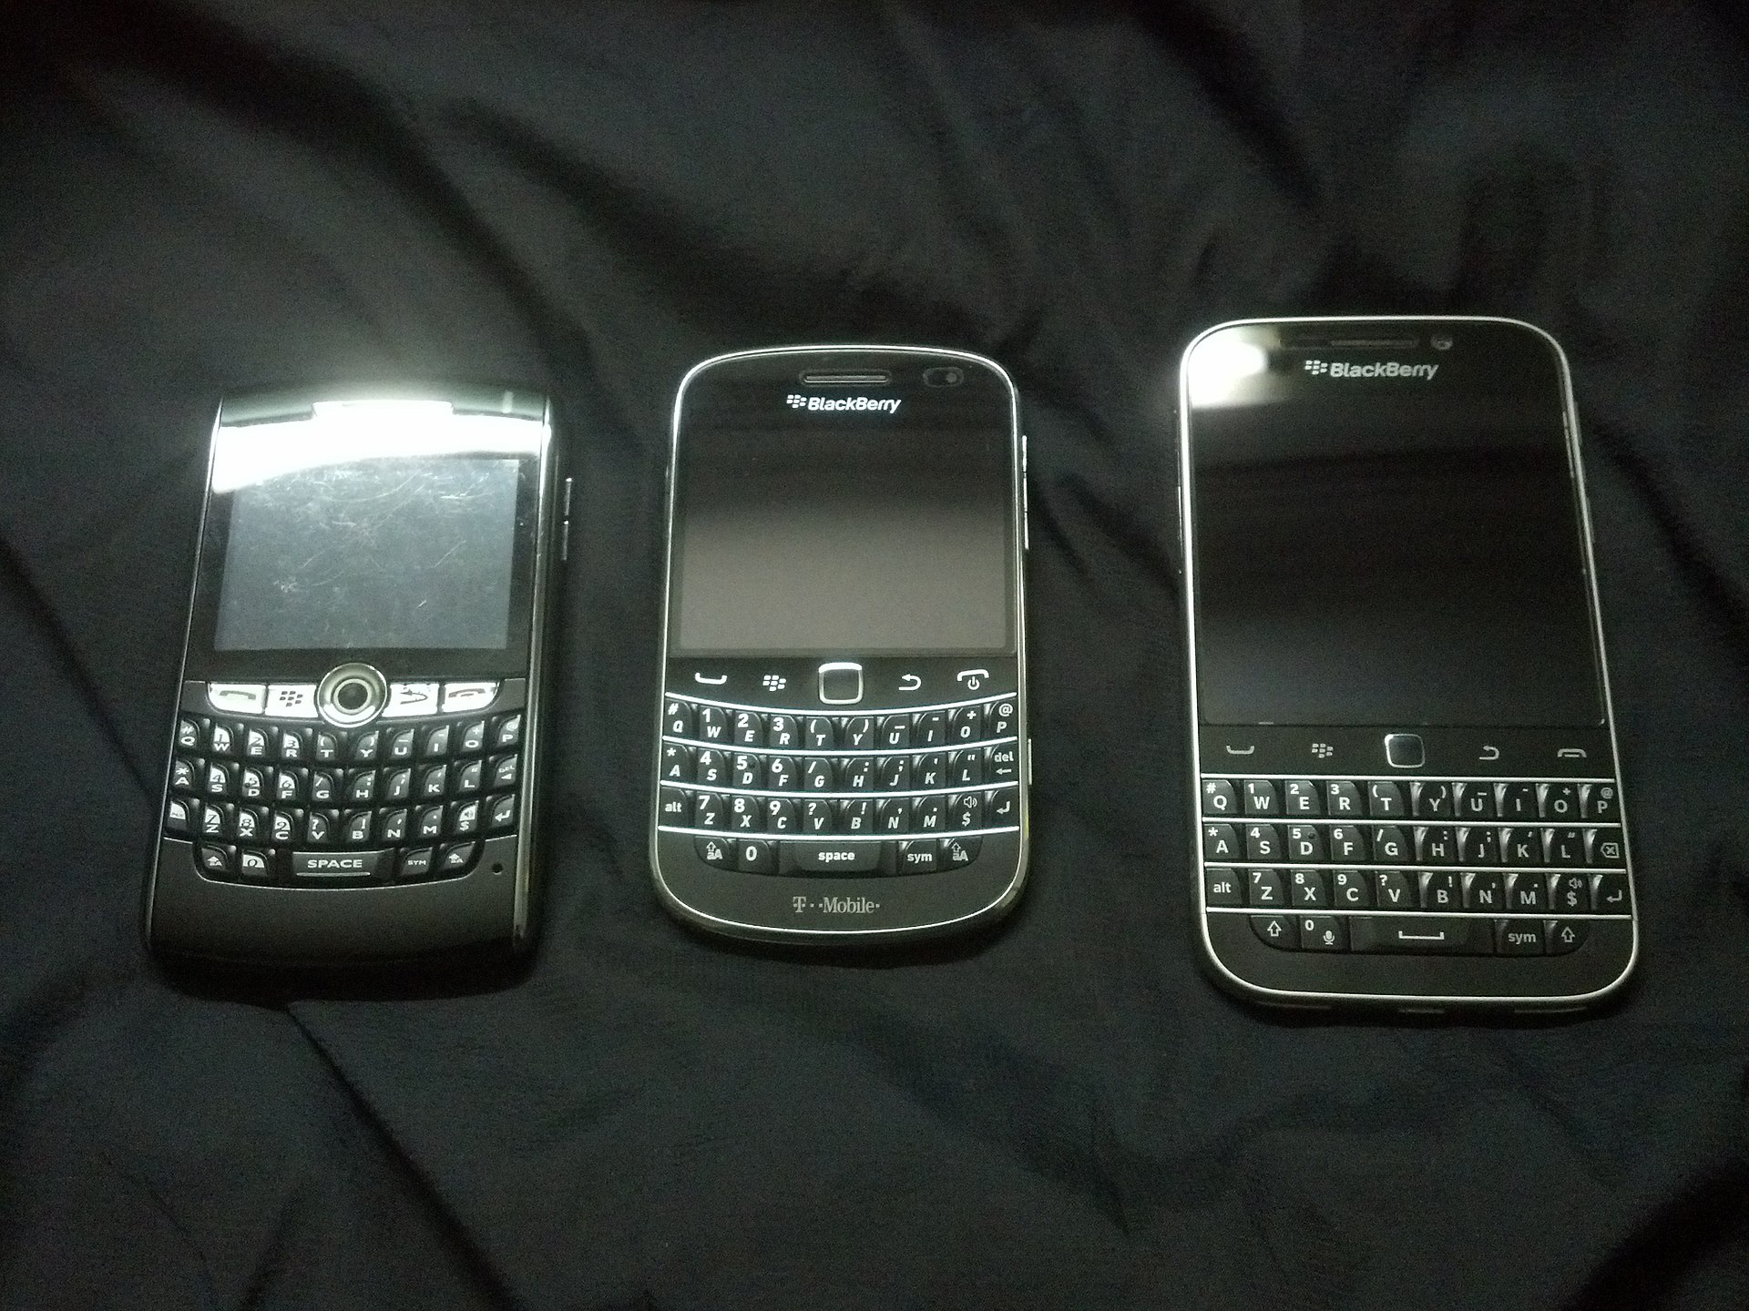
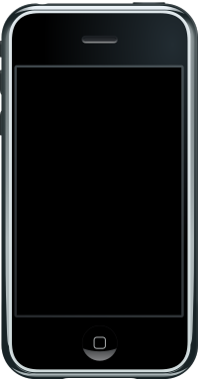
Conceptual Change
Sometimes what the market needs is a change in perception, and again, Apple were the most dramatic tech example recently:
Prior to the iPhone a smart phone was a phone that could do computing. After the iPhone a smartphone was a computer that could make phone calls
Notes:
https://en.wikipedia.org/wiki/BlackBerry
https://en.wikipedia.org/wiki/IPhone_(1st_generation)

Slide 26
Smart Phone revolution
Smartphones have largely displaced laptops
We’re not far off from your smartphone doing most computing for you, and you can plug into a monitor and keyboard for serious work (Microsoft has tech for this already called continuum but no one bought windows phones).
Conceivably with the ‘cloud’ smartphones could become basically just a dumb identification device that streams all of your content to and from web services.

Slide 27
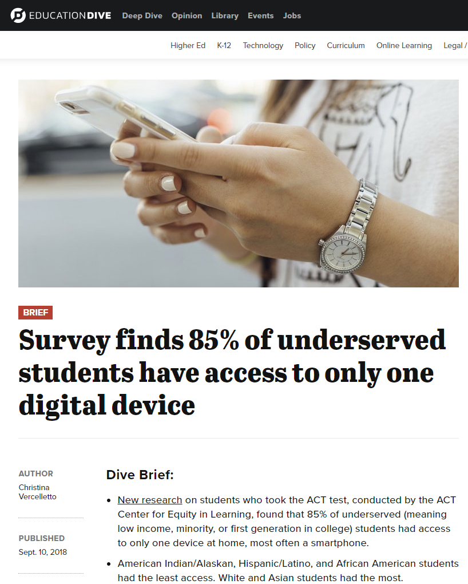
I’m not quite sure where this fits
But it’s worth mentioning that for many people the only Internet access they have is with a smartphone
Notes:
https://www.educationdive.com/news/survey-finds-85-of-underserved-students-have-access-to-only-one-digital-de/531919/

Slide 28
Functionality Back to Your A1/Lab1
What if we maintained the functionality
But did it even more badly
Notes:
Working links to assignment
Shows pictures at user

Slide 29
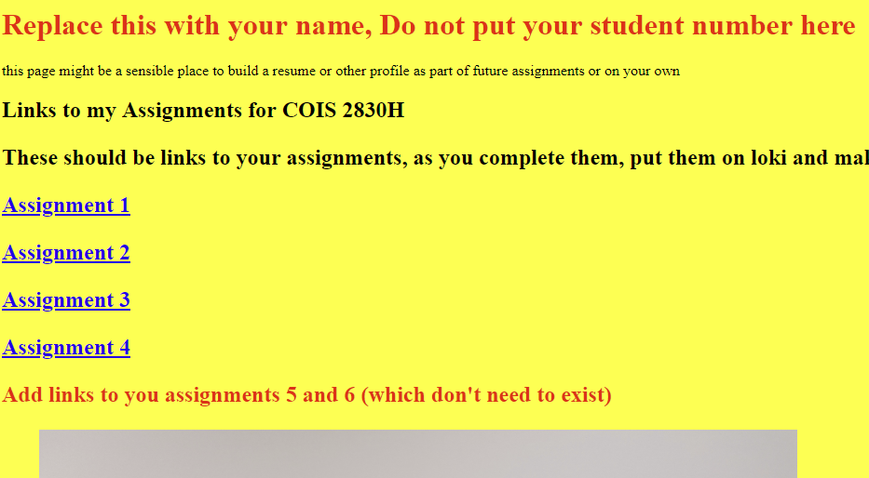
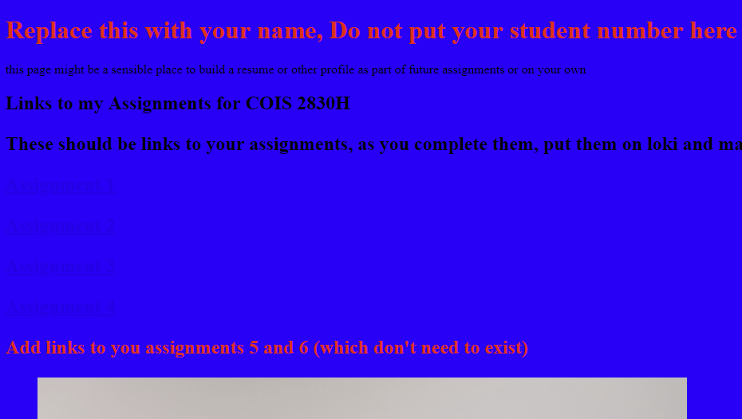
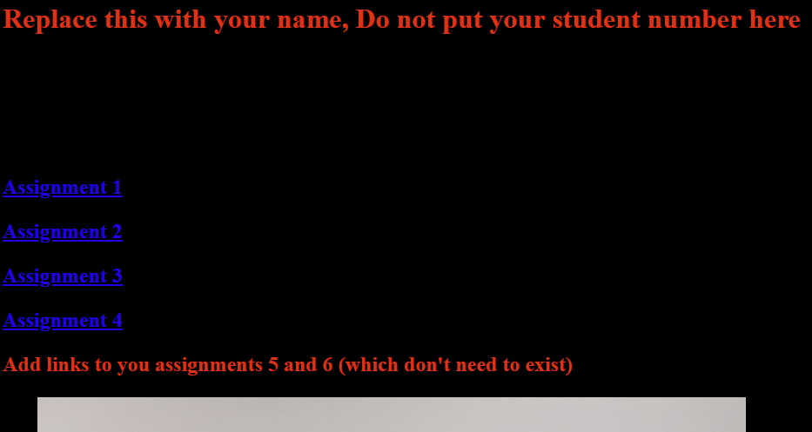
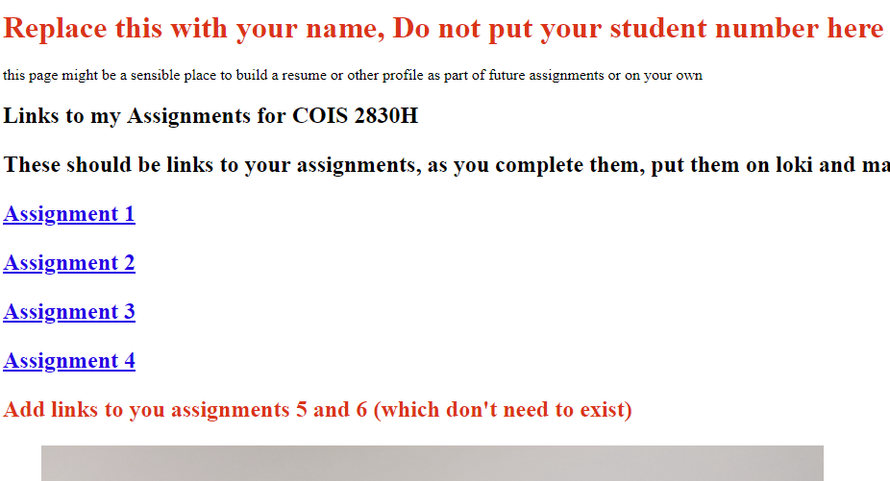

Slide 30
Background-Colour
The only change between those 4 pages is one line (line 6 of the index I gave you in Lab 1)
<body style= "background-color:white"> (yellow, blue, black, white)
Which of the 4 is the least terrible?

Slide 31
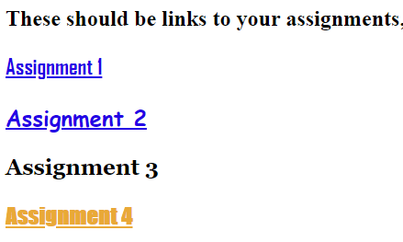
Link Style
What’s wrong with →
Yes those are all valid links (well a screenshot of valid links)

Slide 32
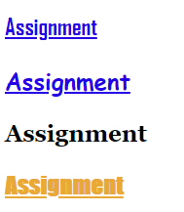
Naming Style
Obviously on a list of 4 elements it’s not exceptionally difficult to pick the 3rd one
But on a big enough list this becomes nearly impossible

Slide 33
Mental Models
We build mental models in about how things work
Part of being a designer is to figure out how people are going to build mental models of whatever you make

Slide 34
Mental models
Mental models are usually formed around a “how do I make it work” rather than “how does it work”.

Slide 35
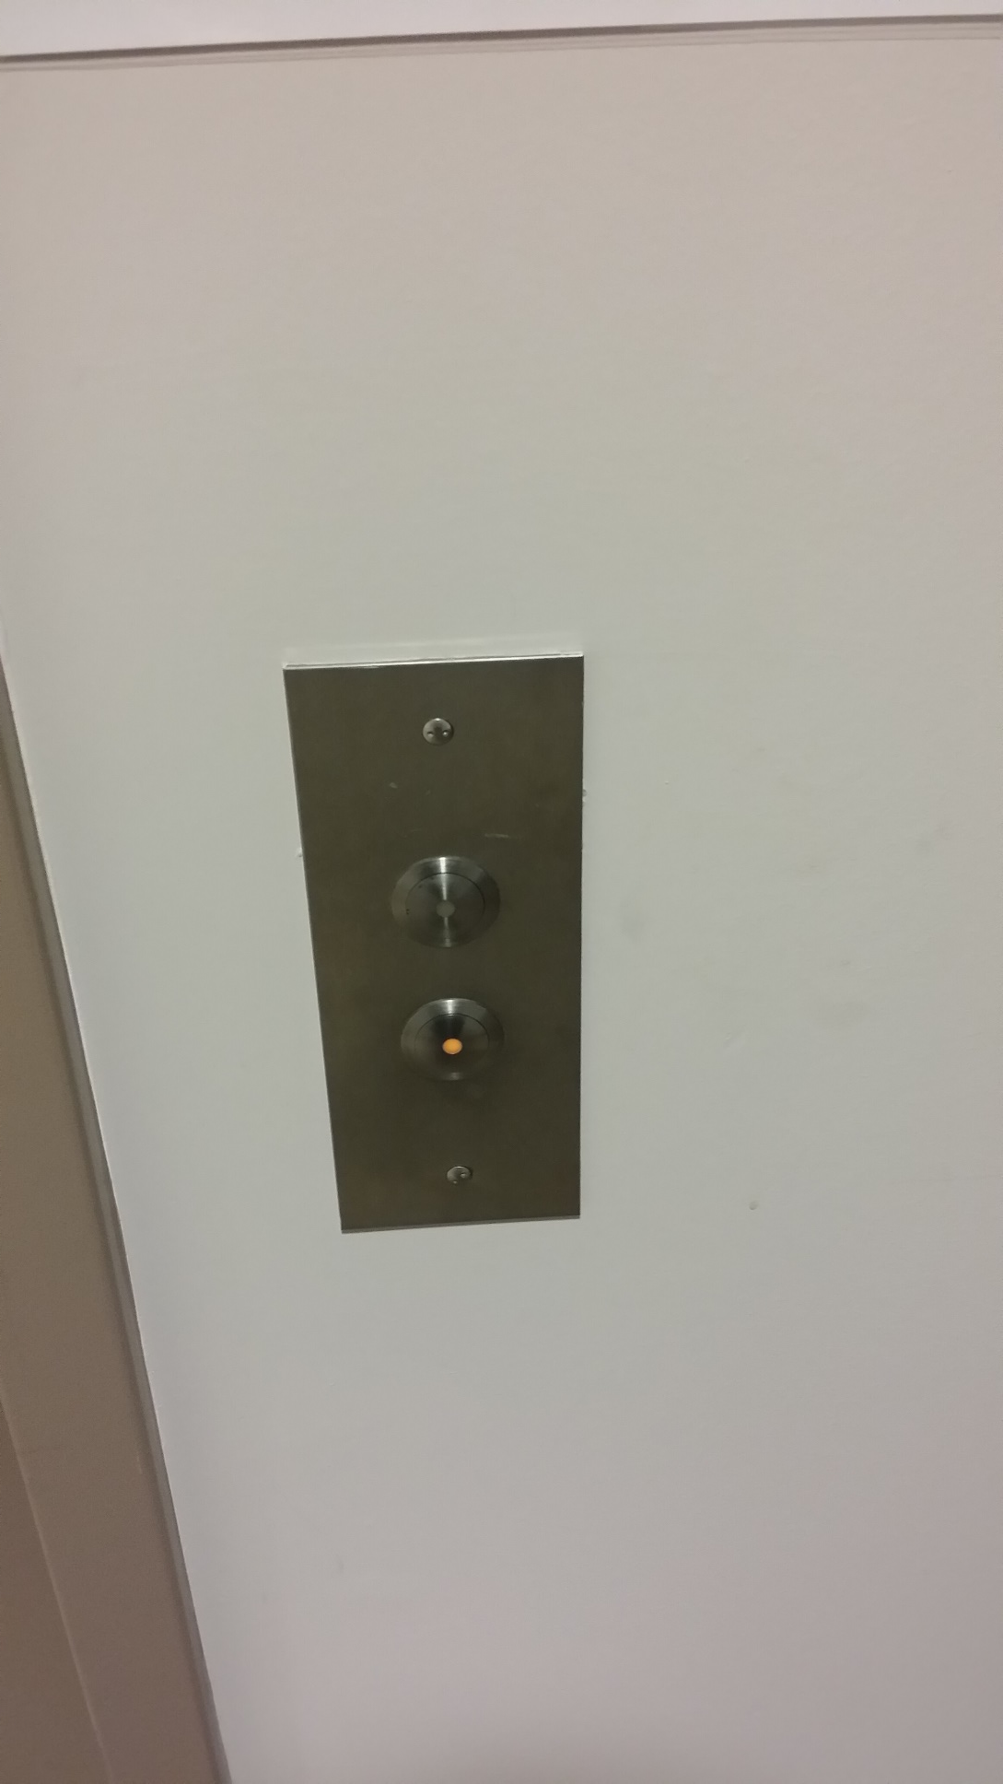
Elevators Buttons
You’d think elevator buttons would be nearly the simplest possible thing for people to understand
And yet….
Notes:
Are you trying to go up or down?

Slide 36

Elevator with front and back doors
Notes:
Point of slide: Elevator with two sets of doors

Slide 37
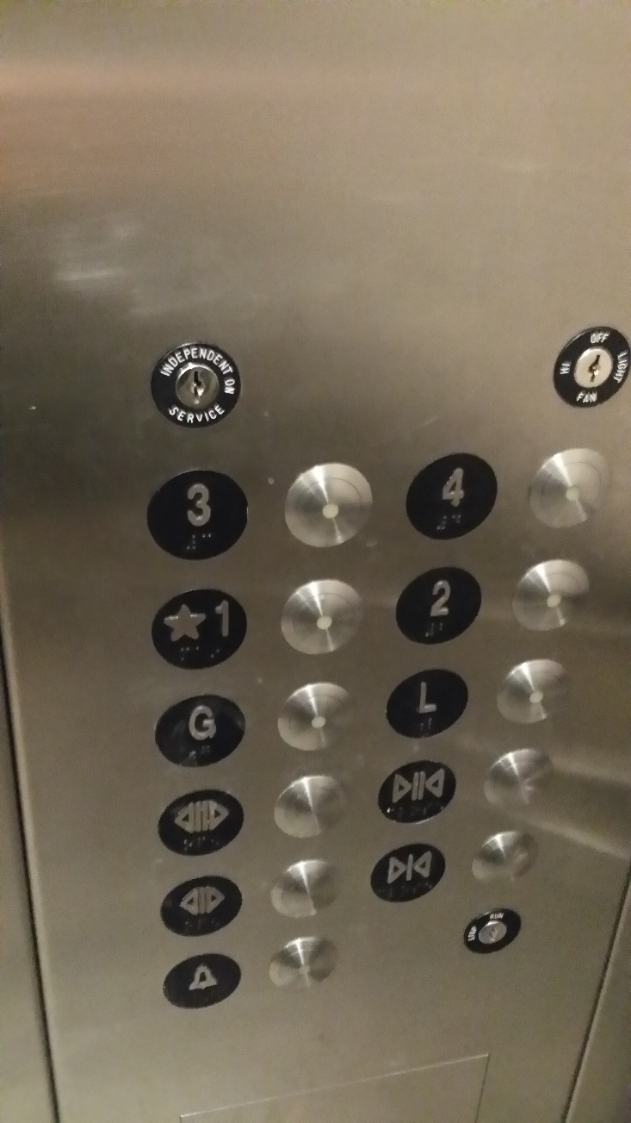
Notes:
Which set of buttons opens which set of doors?

Slide 38
Google – Mental Model
Naively, we would expect two terms together, say “Cat claws” and “Feline claws” to be pretty much the same result
But they aren’t

Slide 39
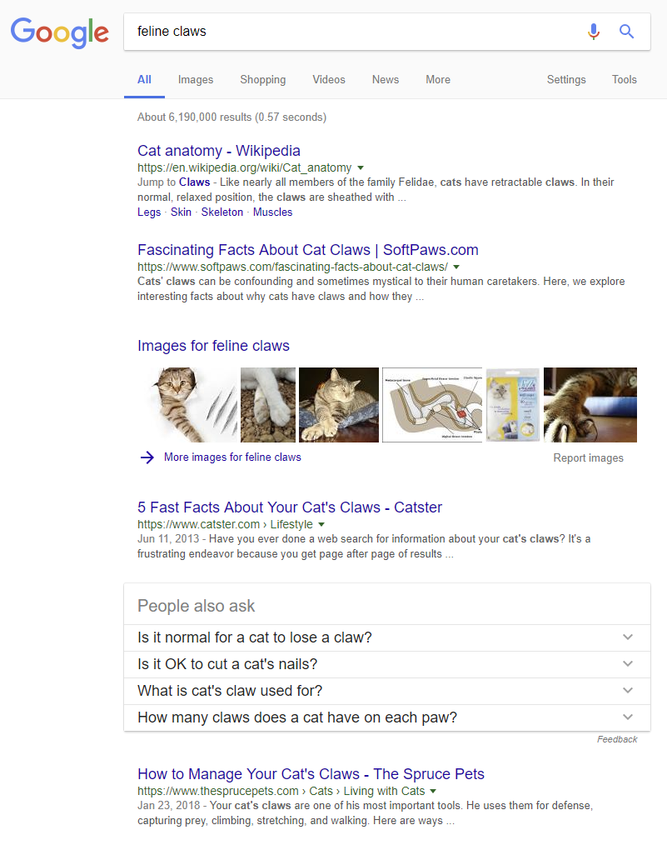
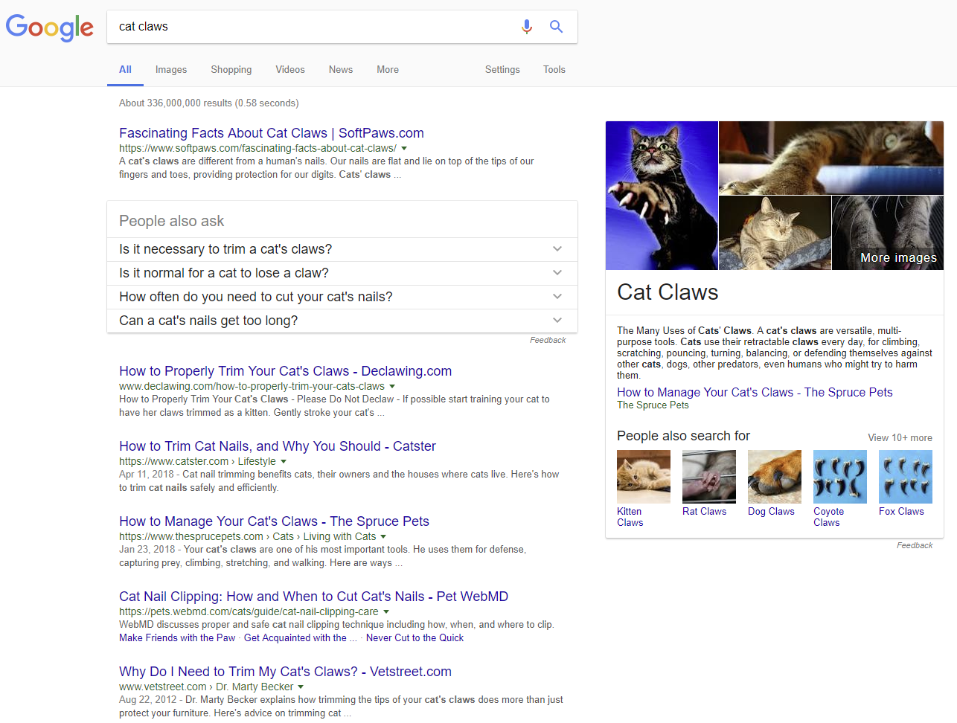
Notes:
Cat claws vs Feline claws, Sri Search, Sept 15 2018
Note that the image on the right is not missing a summary box, it just didn’t exist at all.

Slide 40
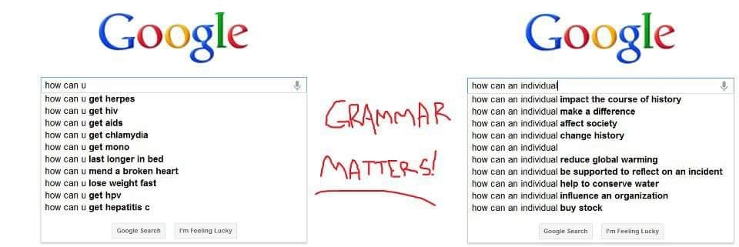
From reddit.com/r/funny
Notes:
https://www.reddit.com/r/funny/comments/8src9p/grammar_really_does_matter/?st=jiomzdi0&sh=31b93103

Slide 41
When I do that
How can u
Sleep
Sleep lyrics
Get herpes
Get mono
Get hep c
How can you
Mend a broken heart lyrics
Mend a broken heart
Get herpes
Get mono
Get HPV
Notes:
No screenshot due to how my browser interacts with screenshots + powerpoint

Slide 42
UX and Google
www.trentu.ca, trentu.ca, loki.trentu.ca, frigg.trentu.ca
m.Wikipedia.org
URLS and UX
Google chrome
https://tech.slashdot.org/story/18/09/08/0437229/google-slammed-over-chrome-change-that-strips-www-from-domain-urls
Notes:
https://tech.slashdot.org/story/18/09/08/0437229/google-slammed-over-chrome-change-that-strips-www-from-domain-urls

Slide 43
Got here in fall 2019

Slide 44
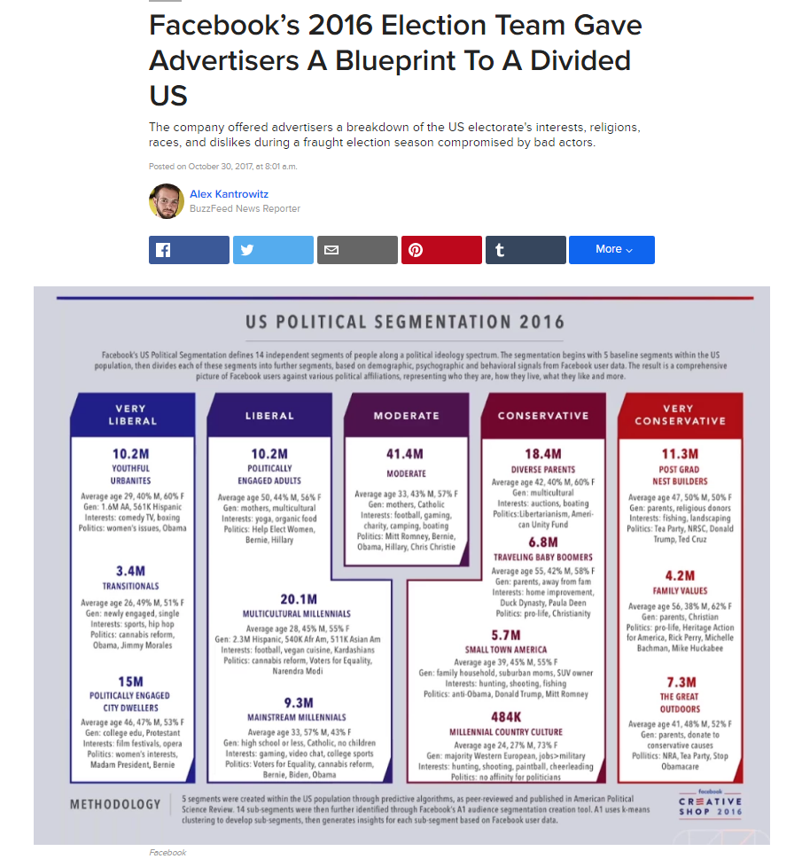
Targeted Advertising
Notes:
https://www.buzzfeed.com/alexkantrowitz/facebooks-2016-election-team-gave-advertisers-a-blueprint?utm_term=.smK5gZjqEX#.ygQ289wymL

Slide 45
Advertising
How targeting to expect ads you see to be?
Do they know your age/location/demographics?
Purchase history?
Etc.

Slide 46
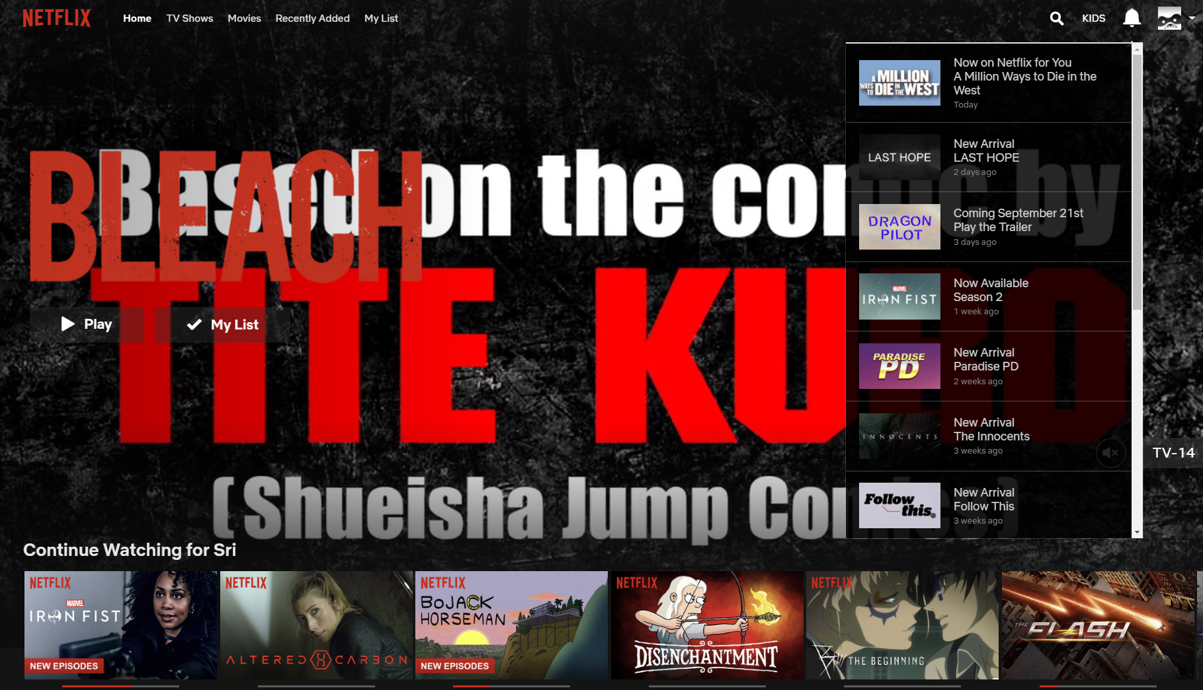
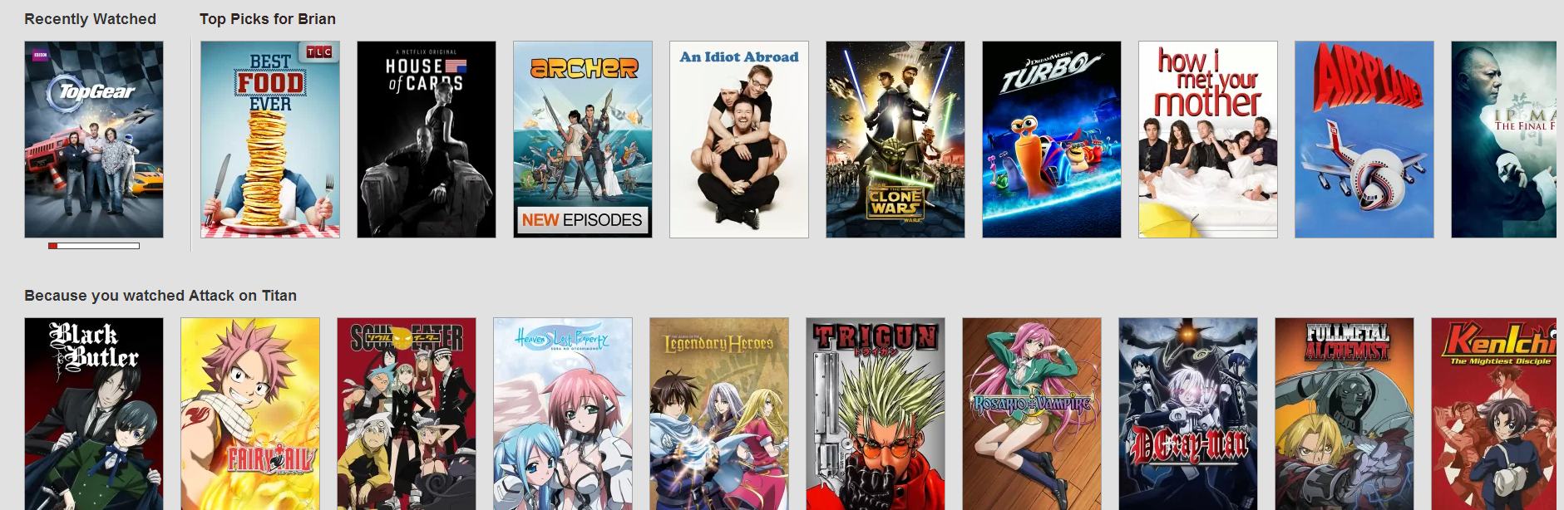
Recommendation
How do you decide what to recommend to someone?
(likes/dislikes past history etc.)
Within that, how do you present information about the item?
Netflix now has a set of icons it uses, and tries to use the one most likely to get you to click on something

Slide 47
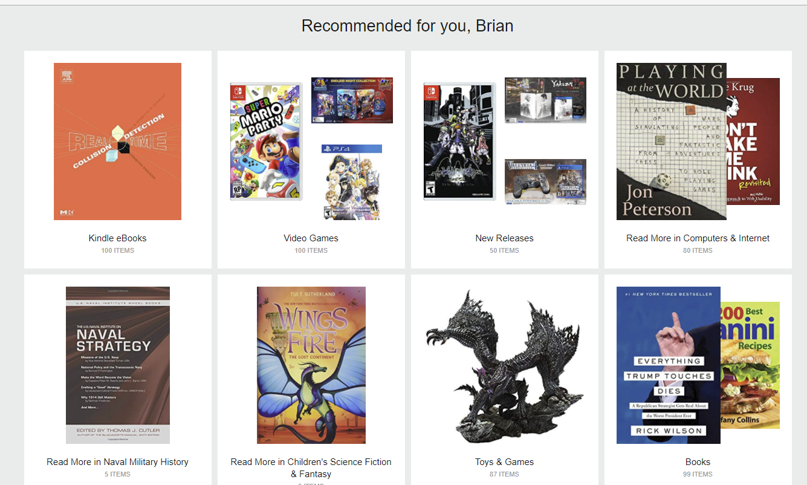
Amazon, Same Problem
Notes:
Sri’s amazon recommendations Sept 15 2018

Slide 48
Gulf of Evaluation
How much effort you must use to know if the thing is working properly
Specialized knowledge
Car control panels
E.g. Antilock braking systems
Is an application starting?
Is this device powered on?
Bluetooth
Notes:
This can be easy or quite complicated ‘properly’ may require some specialized knowledge
Car control panel are now essentially smartphone control panels
Not everyone knows how ABS works, because how often do you have to slam on your brakes.
Particularly when they first introduced ABS a lot of people tried to pump ABS (because that’s what you do when you don’t have ABS)… and that made things worse. A lot worse.
Bluetooth as in Bluetooth pairing.

Slide 49
Gulf of Evaluation
This can be easy or quite complicated ‘properly’ may require some specialized knowledge
Car control panel are now essentially smartphone control panels
Not everyone knows how ABS works, because how often do you have to slam on your brakes.
Particularly when they first introduced ABS a lot of people tried to pump ABS (because that’s what you do when you don’t have ABS)… and that made things worse. A lot worse.
Bluetooth as in Bluetooth pairing.

Slide 50
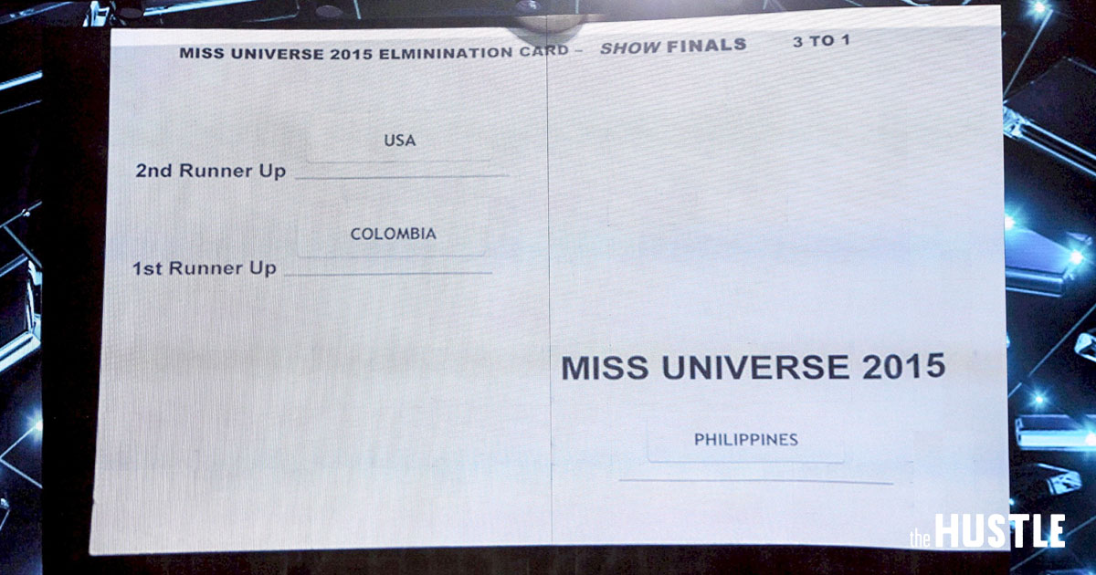
Actual Miss Universe Winner Card
Notes:
Quick – Who won

Slide 51
Gulf of Evaluation Acknowledging Input
Signal Users that they have pressed a button
Can be audio/visual/tactile/all of the above
What about repeated inputs?
Acknowledging every key press when typing can be really annoying
Essentially you overwhelm with feedback
What about very rare inputs?
People may have no idea what the signal is.

Slide 52
Gulf of Evaluation Responding to Input
In mechanical and electrical devices you usually have some sort of immediate action
E.g. a light switch or a door or the like
What if you push on a door and it doesn’t move. Is it locked or stuck?
Software is tricky – what if the CPU is busy?
CPU multitasking is really quite difficult.
Task prioritization is even harder
Ideally you want to not make the user wait for whatever they said ‘do this’, unfortunately physical device limits make that a problem (inductance or capacitance in electrical systems, defects etc.)
Notes:
Ideally you want to not make the user wait for whatever they said ‘do this’, unfortunately physical device limits make that a problem (inductance or capacitance in electrical systems, defects etc.)

Slide 53
GoE in UI design
Interface -> Perception -> interpretation ->evaluation
Which is the same as we talk about here. You have a thing (interface) -> people need gather feedback (perception) -> they need to understand the feedback (interpretation) -> need to know if it’s working

Slide 54
Discovering New Things
(AKA how do you use something you’ve never seen before).
Constraints
Discoverability
Feedback
Cultural conventions

Slide 55
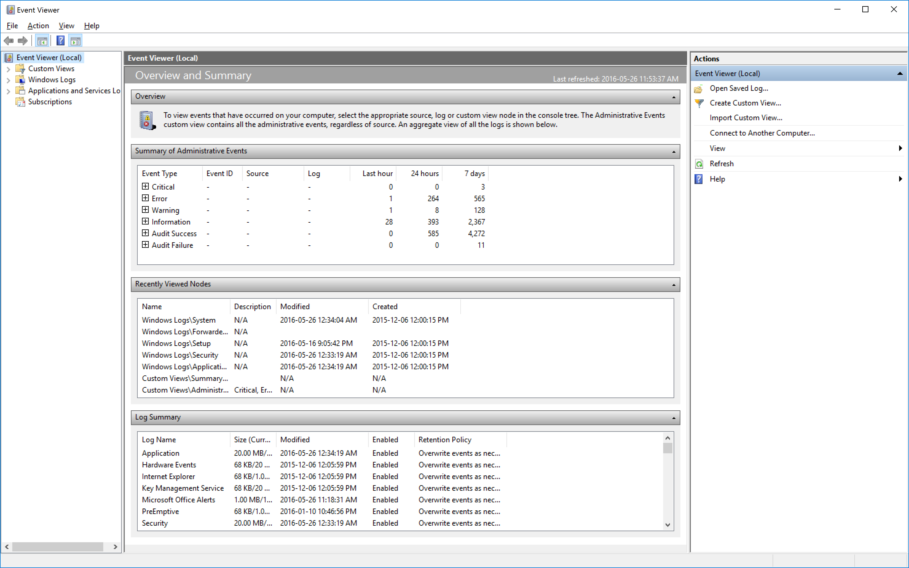
Notes:
E.g. Most of you will have never looked at this event log before. Where is the important part? (hint: Windows Logs -> System, or the critical/error stuff)

Slide 56
Constraints
What can this thing possibly do?
Doors open and close, but can you stick them open or closed
What if they have disabled button access?
Software (and miniaturization) completely breaks intuition about constraints.

Slide 57
Constraints - Physical
Literally the physical limits of a thing
You cannot fit a CD in a tape player
Only useful if you can interpret the physical constraints
Think Ikea furniture where you have many similar pieces that are very precisely for different things (screws and nails have this problem all the time)
Notes:
Batteries that can be put in backwards – still

Slide 58
Constraints - Cultural
You wouldn’t have a CD or a tape player under the taleban
Some things are the way they are because that’s the way they necessarily were (legacy problem).
Cultural constraints is in part the sorts of things you would expect in that area
Notes:
Lots of things

Slide 59
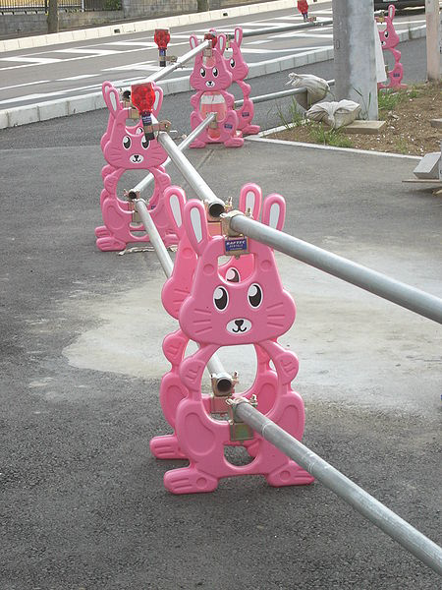
Culture continued
Japanese cuteness
Called Kawaii
If you saw these as road markers here you’d expect there to be more than just… road markers

Slide 60
Culture Continued
Within a culture we have legacy
Blinking headlights on a car means something here (context sensitive signals)
But it means different things in different places
Do you kiss, handshake, bow or something else
Is a head nod yes or no?
Left or Right hand side driving (think driving games)
Each place on the web is it’s own culture but there’s broader Internet cultural conventions about how information is presented
Notes:
http://web-japan.org/trends/09_culture/win_pop09082701.html

Slide 61
Culture
Work hour/Days
Alcohol tolerance at work functions
Religion/Politics
Sleeping on the job/at the office
Diet
Government structure
Housing

Slide 62
Constraints -Semantic
Semantic is hopefully a cultural constraint most of us agree on
What do red lights mean? Stop!
Unfortunately they can change in meaning over time.
Semantic applies to the meaning of the situation
In software testing it refers to only testing things which make sense together
Semantic is meaning from context

Slide 63
Constraints - Logical
If you take something apart and put it back together and have leftover parts you’ve clearly mucked it up
If there are 2 lights and 2 switches well obviously one light should control one switch…

Slide 64
Constraints
Using what we know about constraints we can use them to deliberately constrain bad/unintended/dangerous action
And ideally allow/afford interesting/desirable/useful stuff

Slide 65
Discoverability
How do you know how to work something?
What if you cannot find the controls?
Constraints determine how you can use something
Discoverability is how you actually use the damn thing.

Slide 66
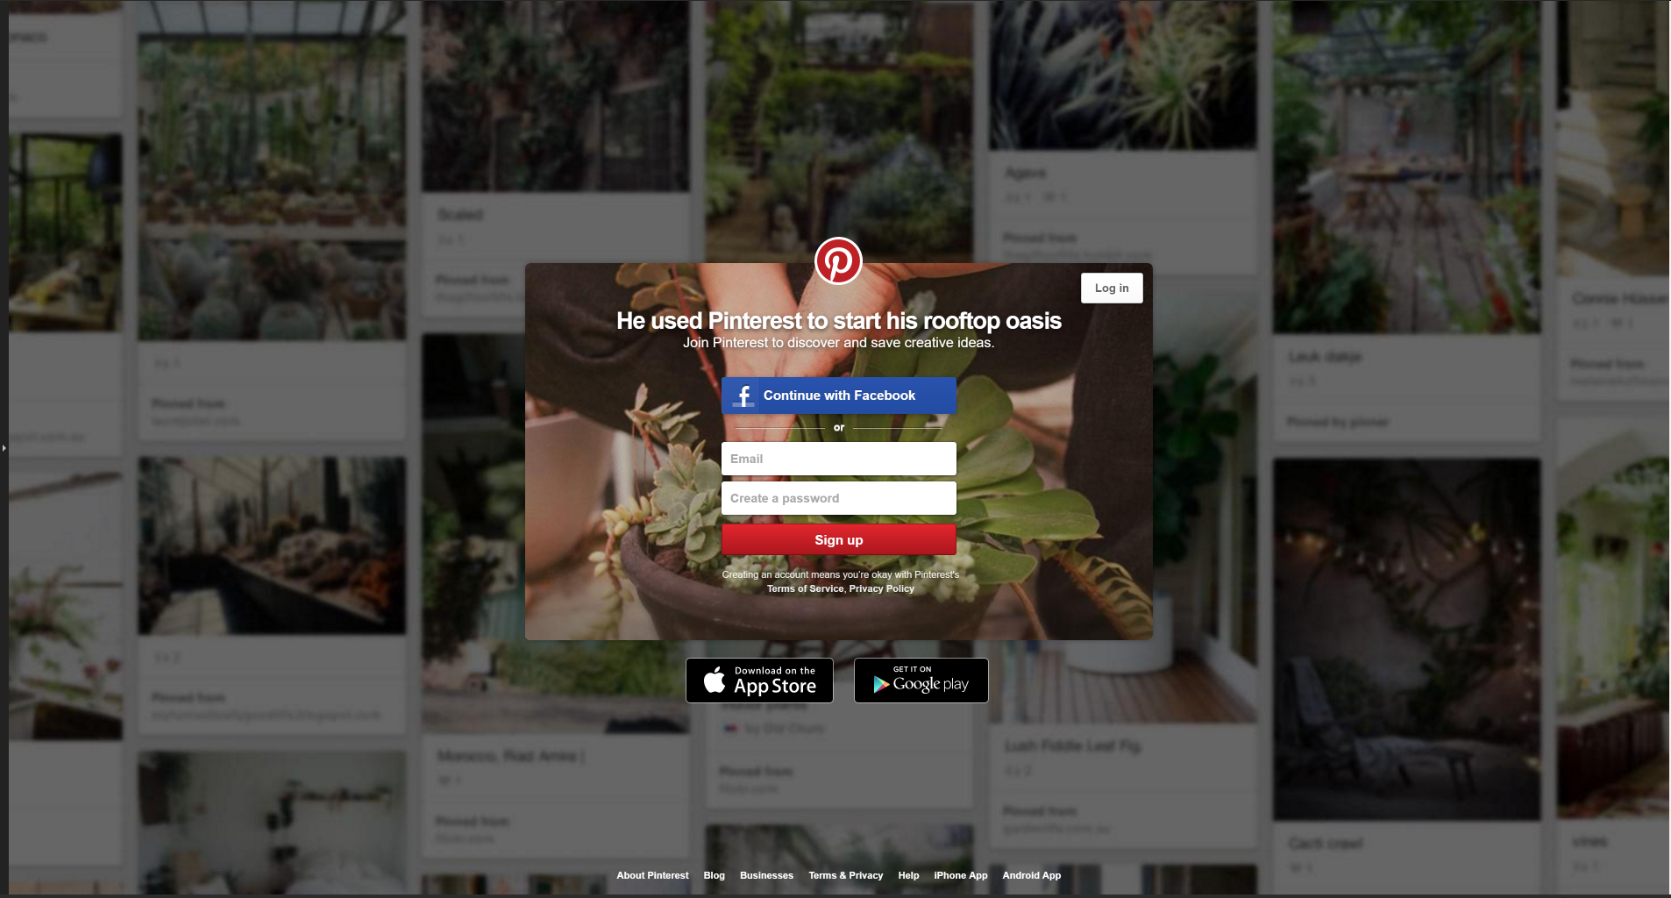
What does this website do?
Notes:
Snipping tool grab of pintrest.com May 26 2016

Slide 67
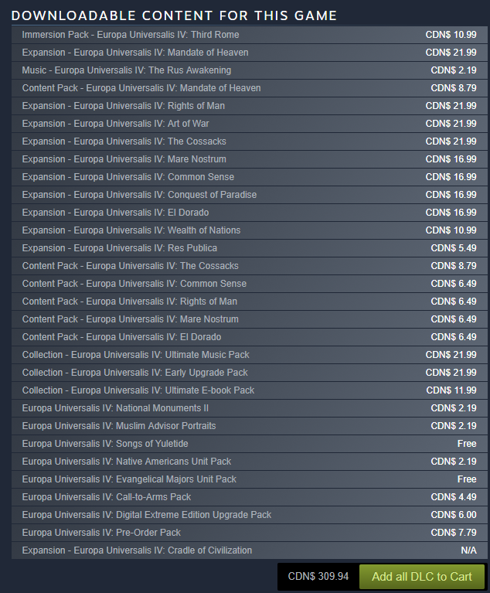
Is Any of That Worth It
Notes:
http://store.steampowered.com/app/236850/Europa_Universalis_IV/

Slide 68
Discoverability
How many clicks from (e.g. the Trent main page) to the thing you want?
At what point do people assuming they are on the wrong track and give up and try something else?
What if they don’t know what the options are?

Slide 69
Discoverability
Ideally you want controls attached to the thing they control
Less ideally they are somehow spatially connected (e.g. in the same room)
Controls arranged in the same spatial organization as the physical things they control
Better than nothing: labels
Notes:
Labels are bad for all of the cultural and semantic reasons we looked at, they might not be clear.

Slide 70
Discoverability – natural mapping
The ideal with discoverability is that you just know how to use something
With electronic devices and software that’s actually quite difficult to achieve.
Sometimes it’s a bit like dating. You don’t know if you’ve had an impact until hours or days later

Slide 71
Feedback
Feedback to input comes in many forms
Audio
Visual (lights, software effect etc)
Animations
Pop up signals.
Finding the right type is a bit challenging
We will talk about the audio side of things next class

Slide 72
Controls
What thing do you use for the interaction
Switches, sensors, gestures, buttons, keyboard shortcuts etc. etc. etc.
Controls naturally constraint how you use an item. On or off switches/buttons for example

Slide 73
Controls: or device centred
Most controls are device centred
That is to say they control a single piece of hardware/software in a single way
This is usually the easiest to engineer
In many cases it’s easy to build a mental model of
But that doesn’t make it the most useful way of doing things

Slide 74
Controls: Activity centred
Controls about an activity are in some ways more useful, particularly to the amateur
E.g. all of the automatic settings on your camera
A collection of ‘default’ settings for different activities
E.g. Presentation mode, movie mode in the theatre etc.

Slide 75
Controls can have a Forcing function
I.e. a device who’s function is to force behaviour/functionality etc
E.g. a lock, password,
More sophisticated engineering options (we’ll cover what they are not how to do them)

Slide 76
Interlock
Safety method to prevent operation without an active user
lawnmowers have (had?) a switch on them where you had to keep the switch depressed for it to keep operating. If you lose control of it down a hill, it stops running the blades.
Confirmation boxes when say, deleting files

Slide 77
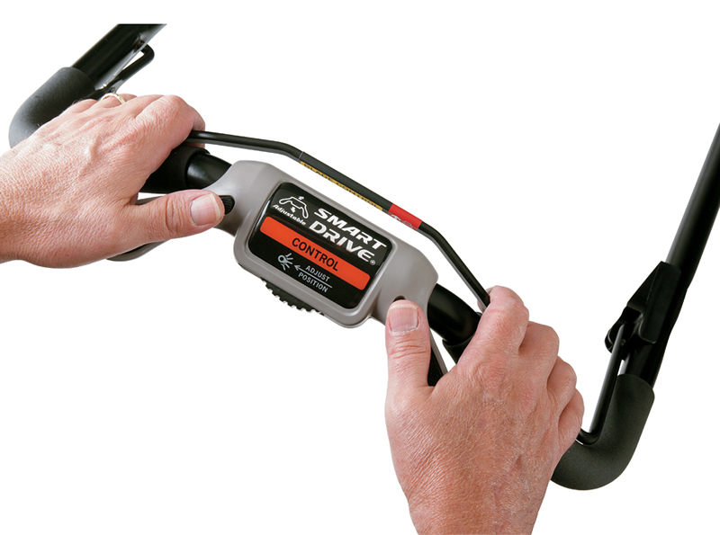
Notes:
http://powerequipment.honda.com/lawn-mowers/models/hrr216vka

Slide 78
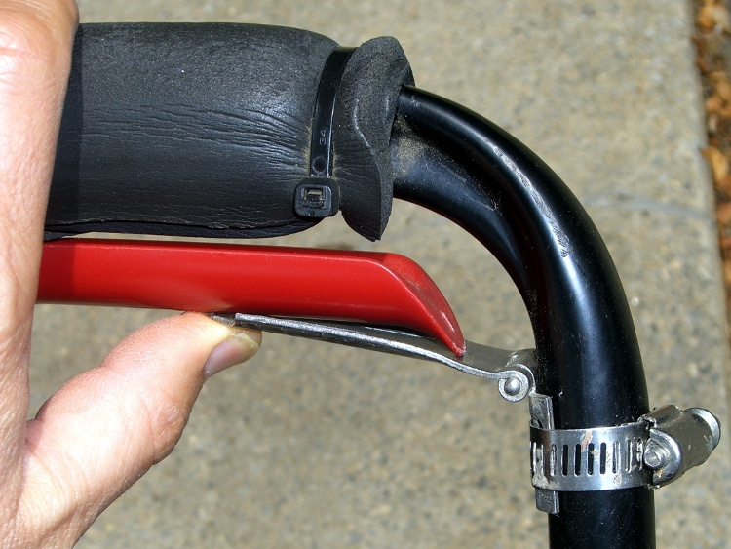
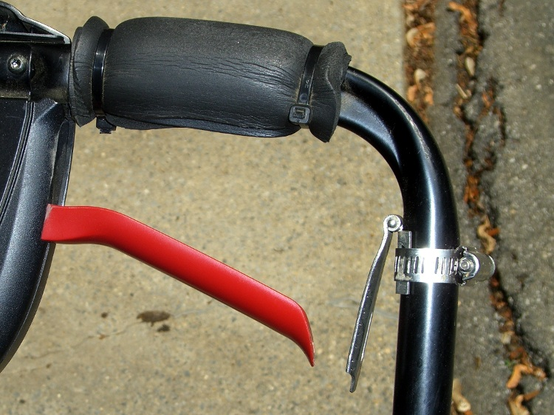
The lock in is sometimes called a ‘deadman grip’ (Aka operator presence control bar)
Notes:
https://softsolder.com/2011/07/05/lawn-mower-drive-control-lever-assist/

Slide 79
Interlocks
Problems with interlocks occur when people try and tie down the interlocks
Or they just ‘click accept’ without thinking about what they are accepting
This arises when interlocks cause too much interference with operation
Serious problem in any sort of design is to balance safety and convenience.

Slide 80
Lock-in
Prevent premature stoppage
E.g. you don’t want to just turn off an airplane in the air, or a car in the middle of the highway
You don’t (usually) want to power off a computer with open files

Slide 81
Lockout
Like a locked door… but more general
Barriers, cages etc.
Keeping you from going somewhere you shouldn’t, particularly in an emergency
Minimizing nuisance with lockouts is a serious problem
Think user account control

Slide 82
Lockout Continued
All of these lock ins and lock outs and interlocks etc are really annoying
People (particularly people that have to deal with them every day) end up disabling them
At which point they were a waste of money, and don’t serve their purpose.
Common problem in the construction industry

Slide 83
Lock in’s and Lock out’s in software
https://martinfowler.com/articles/oss-lockin.html
Windows and Mac Lock you in to a platform, the Google play store and iTunes lock you to their platform
What about open source? Yep

Slide 84
Types of Lock In
Vendor
Product
Version
Architecture (think small vs large files, file structure, etc.)
Platform
Skills
Legal
Mental

Slide 85
Goal of UX
So overall one of the core goals of UX is to get users the thing they want with the minimum of effort
We also want to minimise errors
And not create security issues

Slide 86
A taste of Security and UX
One thing security software does is scan any executed program to make sure it isn’t a virus
That’s a necessary security feature (whether it works or not is another discussion).

Slide 87
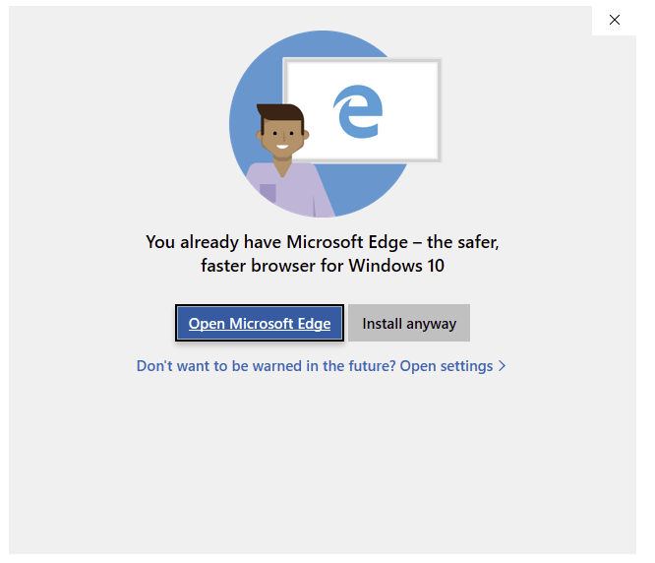
Dear Microsoft: Stop Being Stupid
Notes:
https://www.ghacks.net/2018/09/12/microsoft-intercepting-firefox-chrome-installation-on-windows-10/

